Slide 1

Network Port Scanner GUI
[Student Name:-Manoj S H ]
[AICTE ID : STU6875e4333a4571752556595]

Slide 2

PROBLEM STATEMENT
1.The Graphical User Interface (GUI)
The interface needs to be intuitive. Common elements include:
Input Fields: For the Target IP (e.g., 192.168.1.1) and Port Range (e.g., 20-80).
Buttons: "Start Scan," "Stop/Clear," and "Save Results."
Display Area: A text box or table to show which ports are Open, Closed, or Filtered.
Progress Bar: To give the user visual feedback on the scan completion status.

Slide 3
Project Description A network port scanner is a software tool it’s used to like.. digital security guard, detecting and it’s a probe server or host for TCP/UDP ports

Slide 4

WHO ARE THE END USERS?
Cybersecurity Professionals (Pentesters)
Security experts use these tools during the "Reconnaissance" phase of an audit.
Vulnerability Assessment: Identifying open ports is the first step in finding out if a system is running outdated or insecure software.
Ethical Hacking: They simulate an attack to show a company where their "digital windows" are left unlocked.

Slide 5

Technology Used
1. Programming Languages
While many languages can handle networking, these three are the industry favorites for this specific project:
Python: The #1 choice for beginners and security pros due to its massive library support and readability.
C# (.NET): Preferred for creating high-performance, native Windows applications with polished interfaces.
Java: Used when the scanner needs to run identically on Windows, macOS, and Linux (Cross-platform).

Slide 6
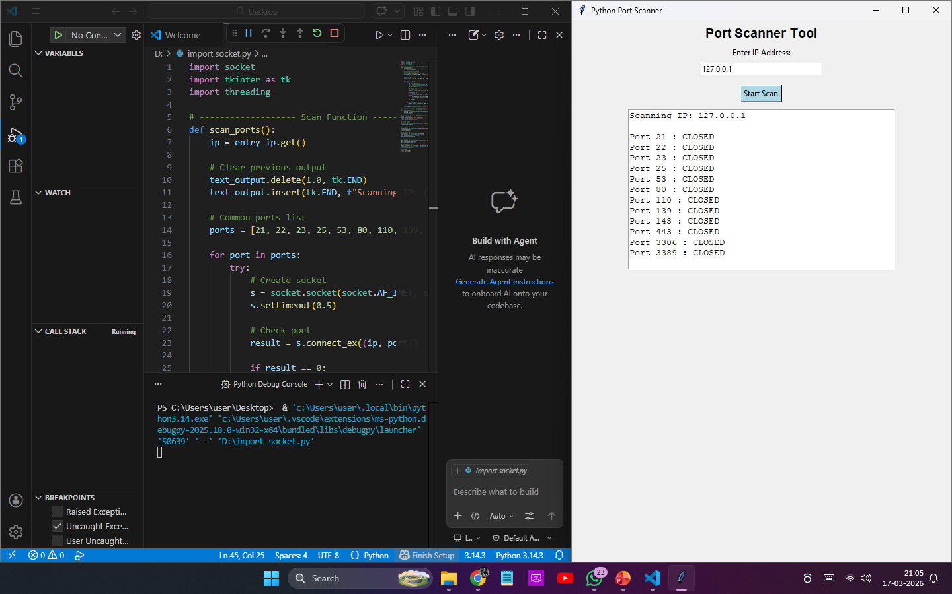
RESULTS
[Add screen shots of your code ]
https://github.com/manojmanoj200725-ui/Network-Port-Scanner-GUI-.git

Slide 7
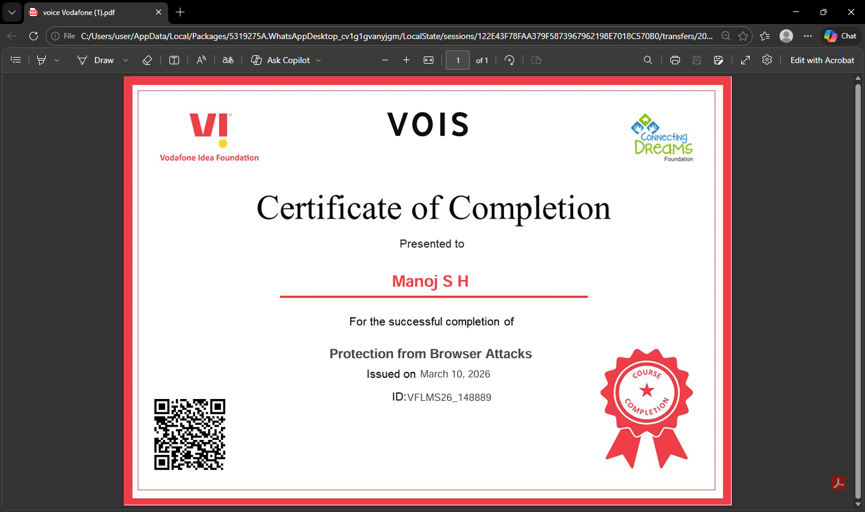
Certificate - Protection from browser attacks

Slide 8
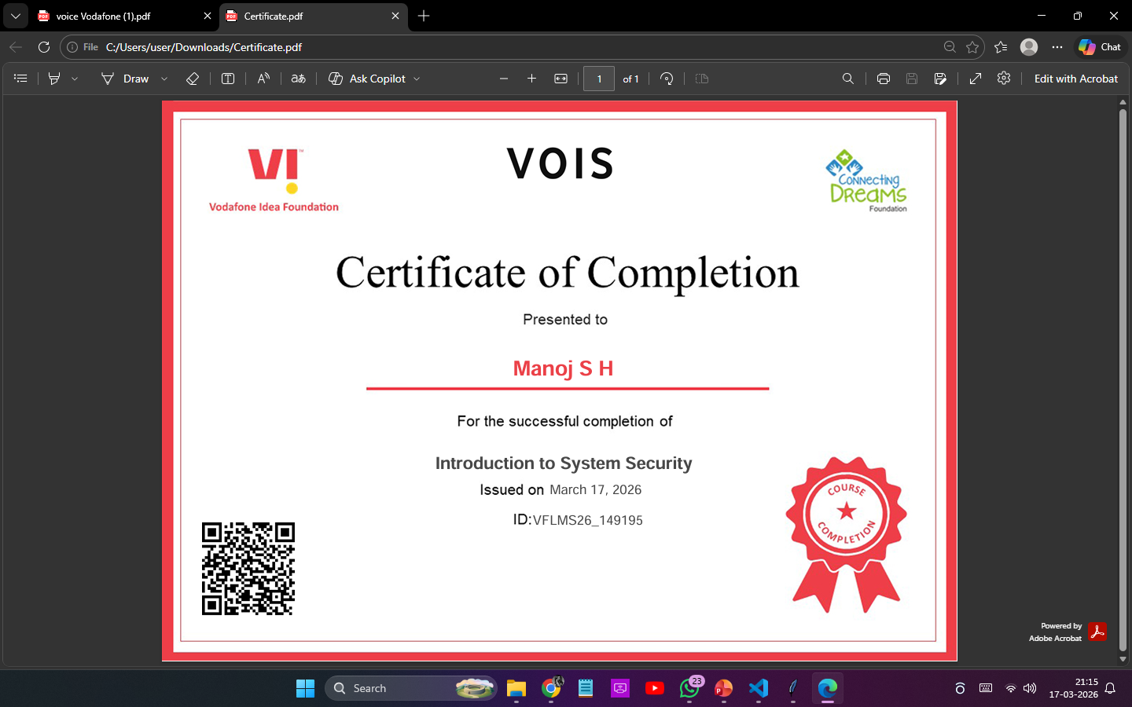
Certificate - Introduction to System Security

Slide 9
GitHub link
https://github.com/manojmanoj200725-ui

Slide 10
Thank you
.
.

